Slide 1
From greenhouse effect to the Paris Agreement: Exploring Manabe’s Nobel-winning-work in predicting global warming
Ryan Shìjié Dù
cSplash 2023
04/22/2023 (Earth Day)

Slide 2
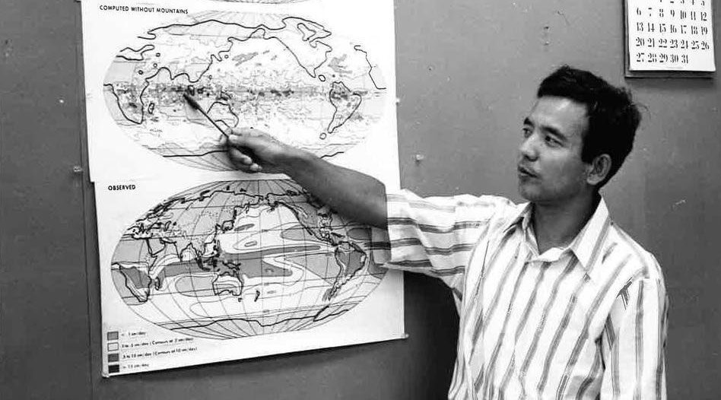
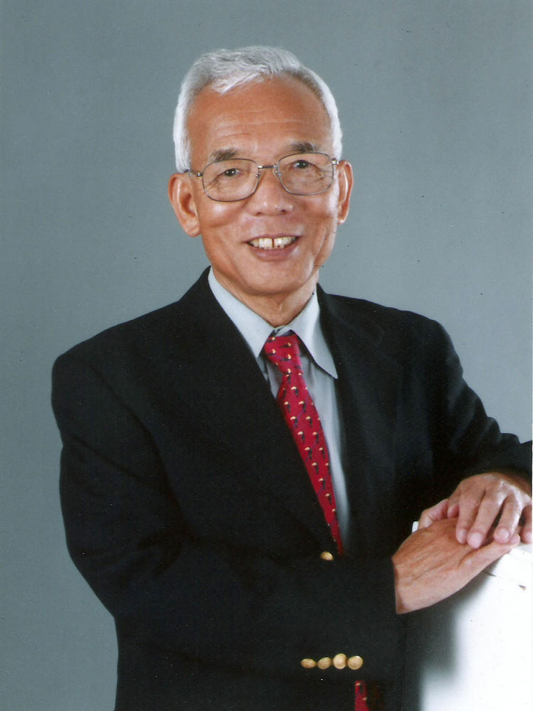
Syukuro "Suki" Manabe 真鍋 淑郎
Nobel Prize motivation: “for the physical modelling of Earth’s climate, quantifying variability and reliably predicting global warming”
Photos from Geophysical Fluid Dynamics Laboratory and Franklin Institute

Slide 3
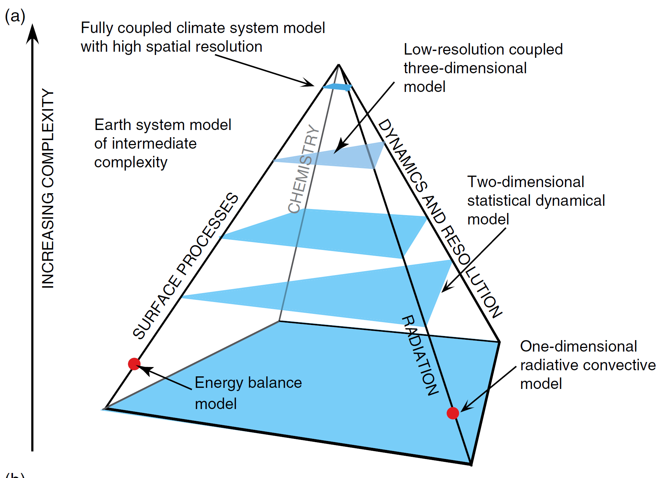
Hierarchy of models
Energy balance
0D, one-layer atmosphere
Greenhouse effect
One vertical column
Manabe and Wetherald (1967)
3D model
Manabe and Wetherald (1975)
Earth system model
Use nowadays in the Intergovernmental Panel on Climate Change Assessment Report (e.g.: IPCC-AR6 published in 2022)
McGuffie, Kendal, and Ann Henderson-Sellers. 2014. The Climate Modelling Primer. John Wiley & Sons.

Slide 4
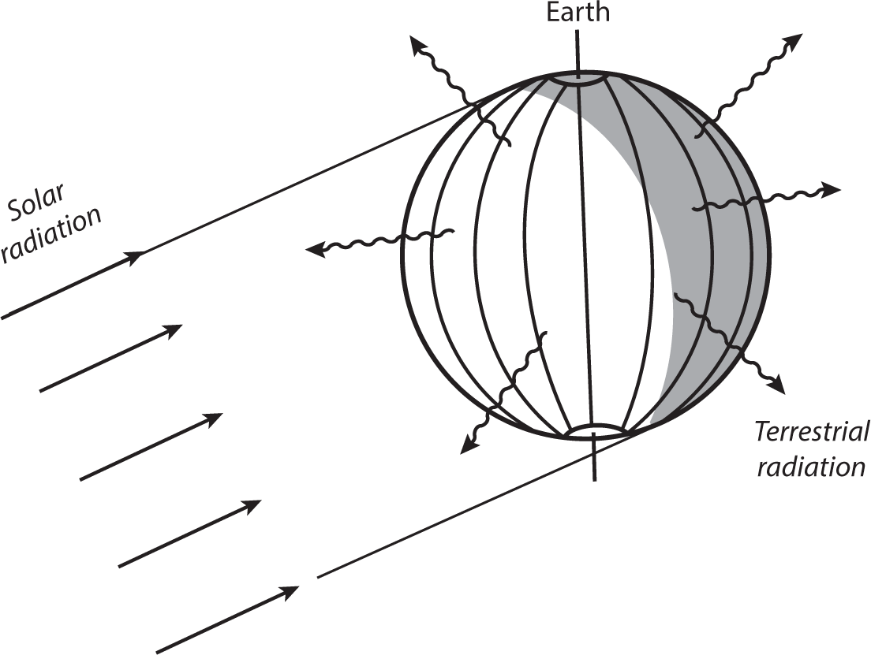
Energy balance model - Bare rock
Energy in
Radiation from the sun about 340 Wm⁻²
Energy out
Reflection of solar radiation 101 Wm⁻²
Radiation of the earth ???? Wm⁻²
Energy in = Energy out
Terrestrial radiation about 240 Wm⁻²
Stefan–Boltzmann law of radiation
Effective emission temperature of the earth
-18.7 °C = -1.7 °F
Manabe, Syukuro, and Anthony J. Broccoli. 2020. Beyond Global Warming: How Numerical Models Revealed the Secrets of Climate Change. Princeton University Press.

Slide 5
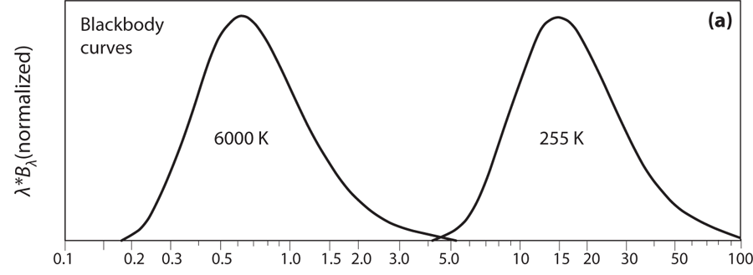

Too cold! Greenhouse effect
Hotter object emits shorter waves
The sun (6000 K):
Shortwave radiation invisible to greenhouse gases
Includes the visible spectrum
The earth’s emission temp (255 K):
Longwave radiation easily absorbed by greenhouse gases
Wavelength (μm)
Peixoto, José Pinto. 1992. Physics of Climate. American Institute of Physics.

Slide 6
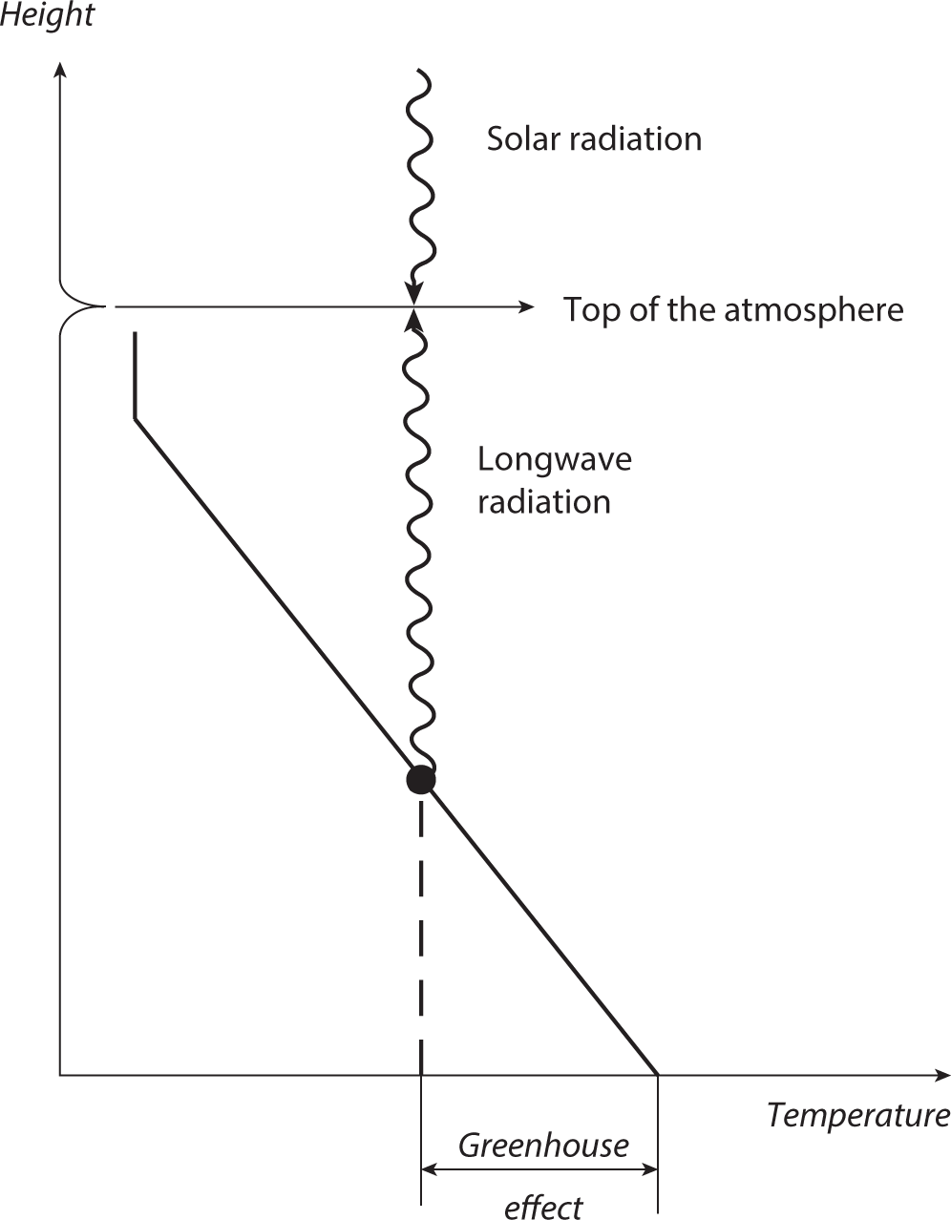
A simple energy balance model
Effective emission temperature of the earth:
255 K
“Effective emission height”:
5 km
Typical lapse rate of the troposphere:
6.5 K/km
Greenhouse effect:
32.5 K
Temperature on the surface
287.5K= 14.4 °C = 57.8 °F
Manabe, Syukuro, and Anthony J. Broccoli. 2020. Beyond Global Warming: How Numerical Models Revealed the Secrets of Climate Change. Princeton University Press.

Slide 7
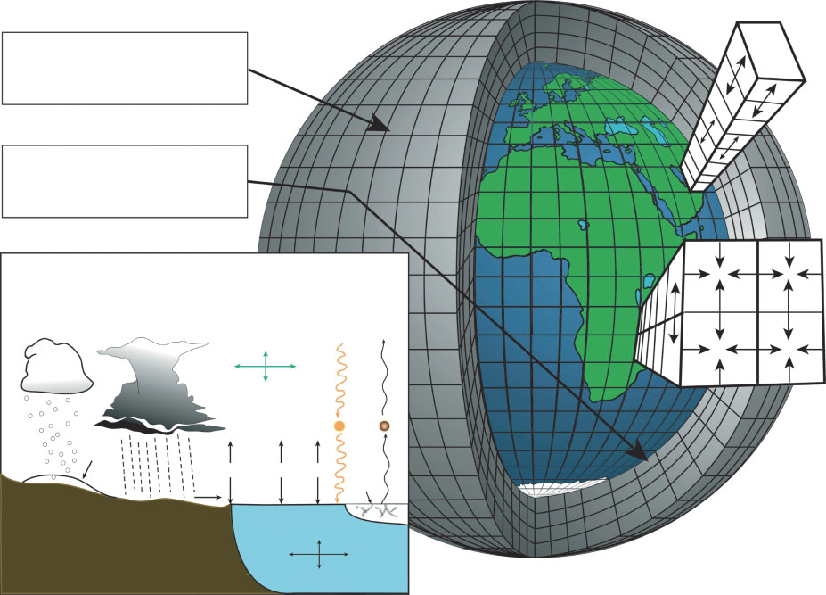
1D Vertical Column Model
Edwards, Paul N. 2011. “History of Climate Modeling.” WIREs Climate Change 2 (1): 128–39.

Slide 8
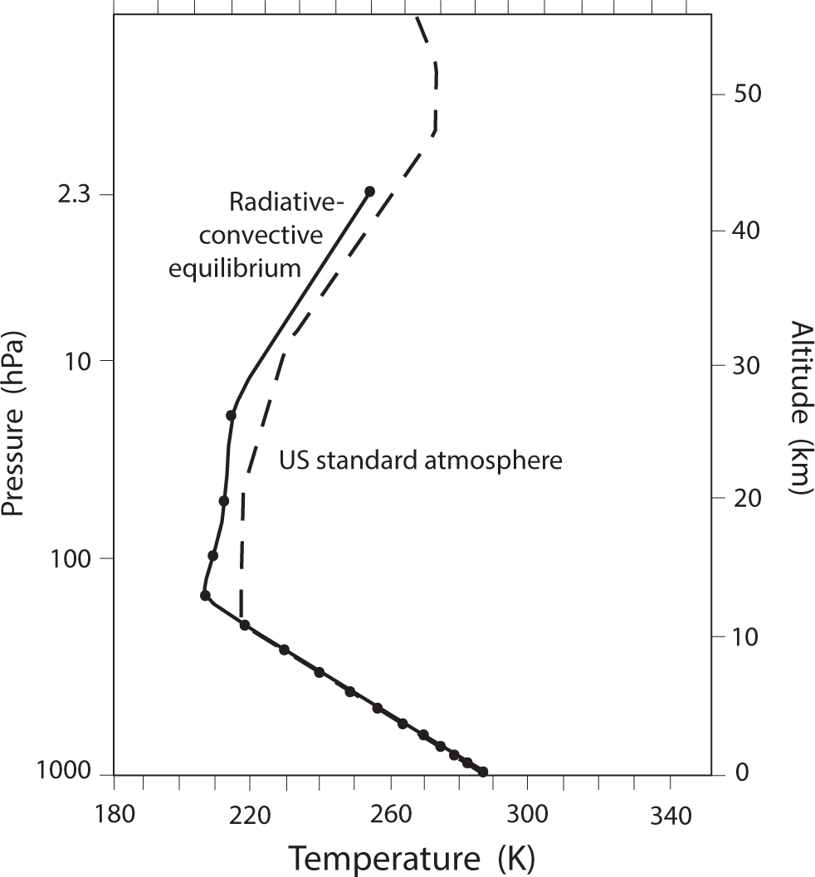
Radiative-Convective Equilibrium
One-dimensional vertical column
Energy balance at each vertical level
Absorption of shortwave radiation
Absorption and emission of longwave radiation
The lapse rate cannot exceed the critical 6.5 K/km
Equilibrium solution (no time change)
Critical paper: Manabe and Strickler (1964)
Manabe, Syukuro, and Anthony J. Broccoli. 2020. Beyond Global Warming: How Numerical Models Revealed the Secrets of Climate Change. Princeton University Press.

Slide 9
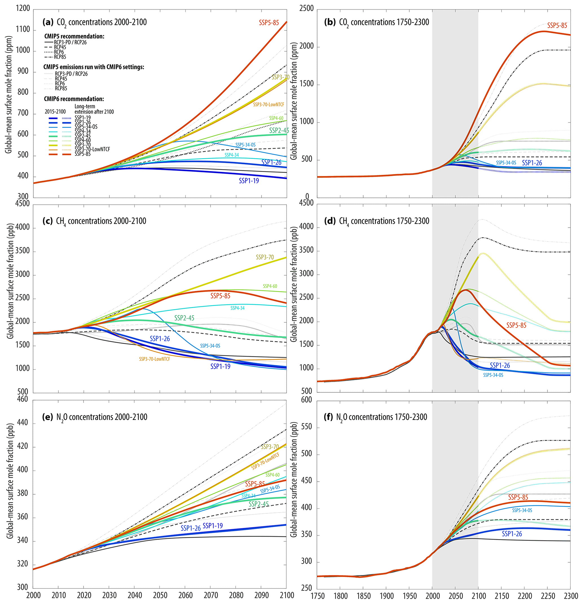
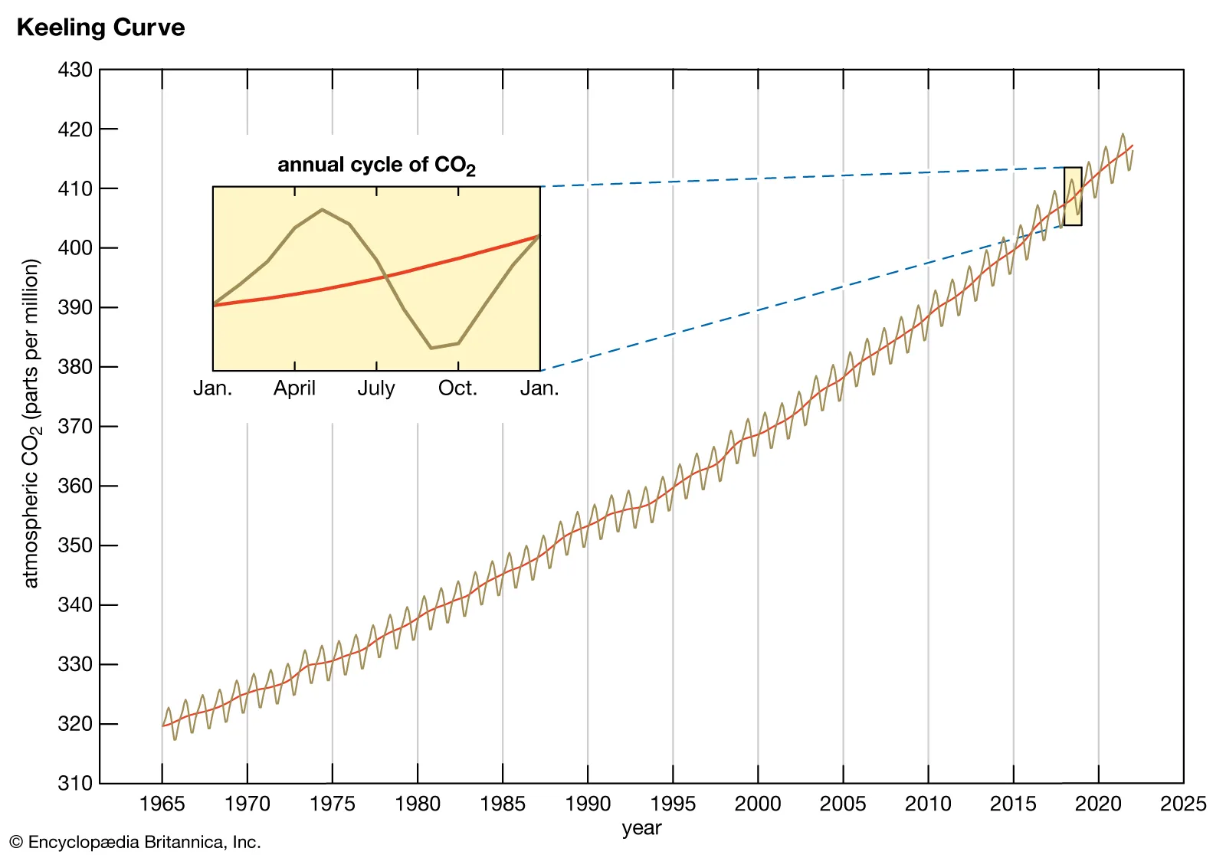
Anthropogenic CO₂
The Keeling curve: Observed CO₂ concentration in the atmosphere
Shared Socioeconomic Pathways (SSPs): keys future emissions scenarios
Rafferty, J. P.. "Keeling Curve." Encyclopedia Britannica. https://www.britannica.com/science/Keeling-Curve. Keeling curve data from Scripps Institution of Oceanography
Meinshausen, Malte, Zebedee R. J. Nicholls, Jared Lewis, Matthew J. Gidden, Elisabeth Vogel, Mandy Freund, Urs Beyerle, et al. 2020. “The Shared Socio-Economic Pathway (SSP) Greenhouse Gas Concentrations and Their Extensions to 2500.” Geoscientific Model Development 13 (8): 3571–3605. https://doi.org/10.5194/gmd-13-3571-2020.

Slide 10
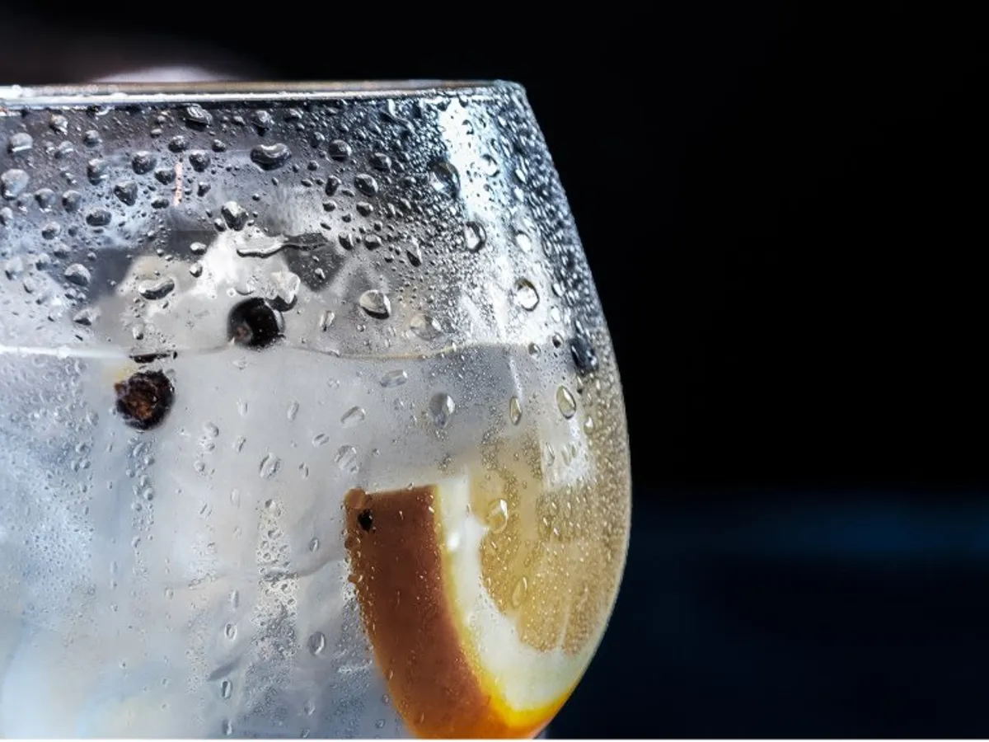
Water vapor is a Greenhouse gas
High impact, short lived
Warmer air can hold more water vapor
Clausius–Clapeyron relation
The relative humidity in the atmosphere does not change much as temperature changes
From our seasonal variation
Assume constant relative humidity
More water vapor as the earth warms
Manabe, Syukuro, and Richard T. Wetherald. 1967. “Thermal Equilibrium of the Atmosphere with a Given Distribution of Relative Humidity.” Journal of the Atmospheric Sciences 24 (3): 241–59.

Slide 11
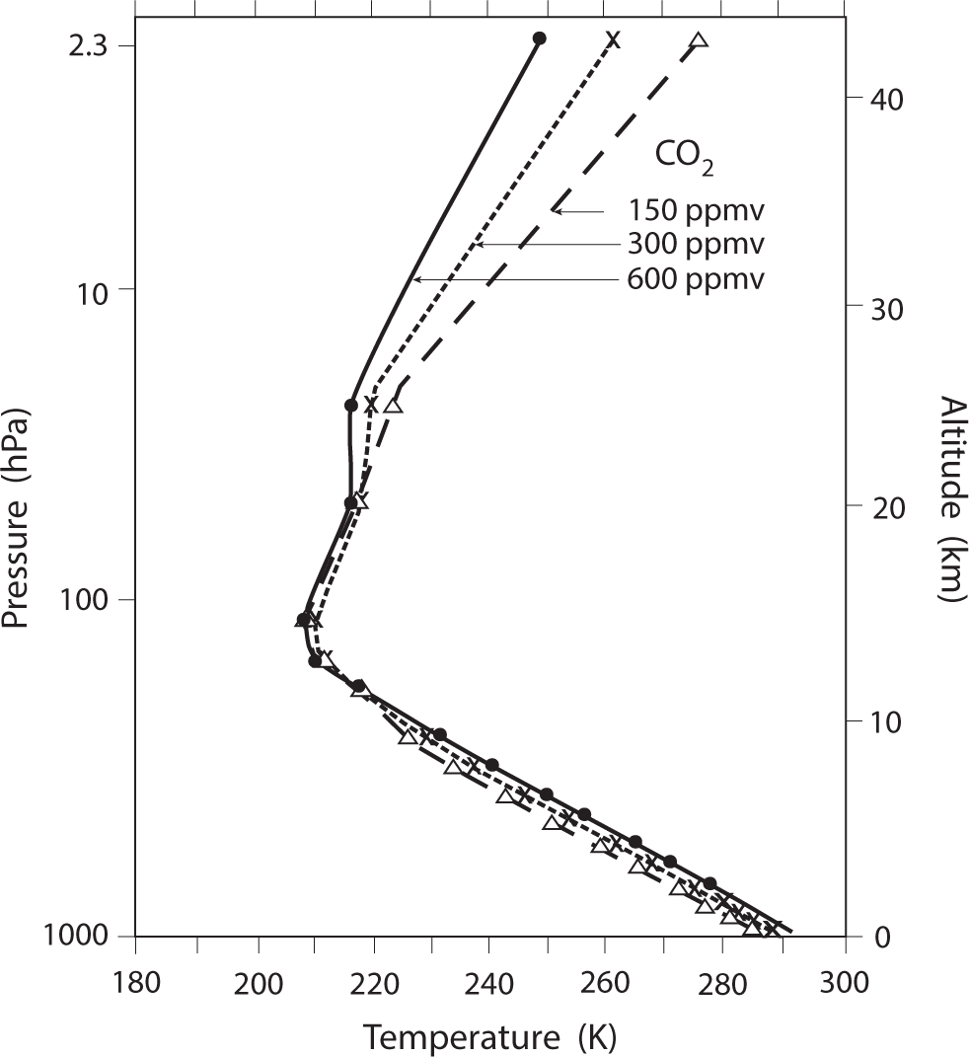
Doubling CO₂: Equilibrium Climate Sensitivity
CO₂: 300 ppmv v.s. 600 ppmv
Water vapor (positive) feedback (on or off)
Fix specific humidity: 1.3 K (2.3 °F) warming
Fix relative humidity: 2.4 K (4.3 °F) warming
Critical paper: Manabe and Wetherald (1967)
Manabe, Syukuro, and Richard T. Wetherald. 1967. “Thermal Equilibrium of the Atmosphere with a Given Distribution of Relative Humidity.” Journal of the Atmospheric Sciences 24 (3): 241–59.

Slide 12
Early and current 3D global models

Slide 13
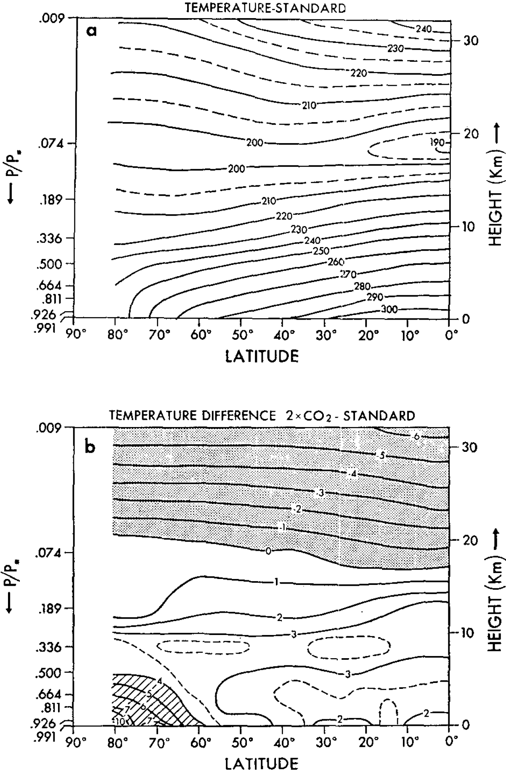
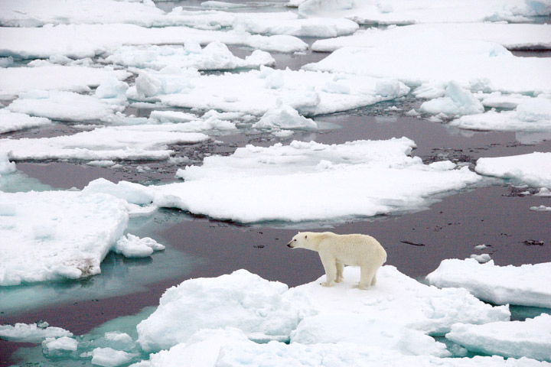
Three-Dimensional General Circulation Model
Similar in vertical profile
More warming near the pole due to albedo feedback
Global average warming of 2.93 K (5.27 °F)
Critical paper: Manabe and Wetherald (1975)
https://earthobservatory.nasa.gov/features/SeaIce
Manabe, Syukuro, and Richard T. Wetherald. 1975. “The Effects of Doubling the CO2 Concentration on the Climate of a General Circulation Model.” Journal of the Atmospheric Sciences 32 (1): 3–15.

Slide 14
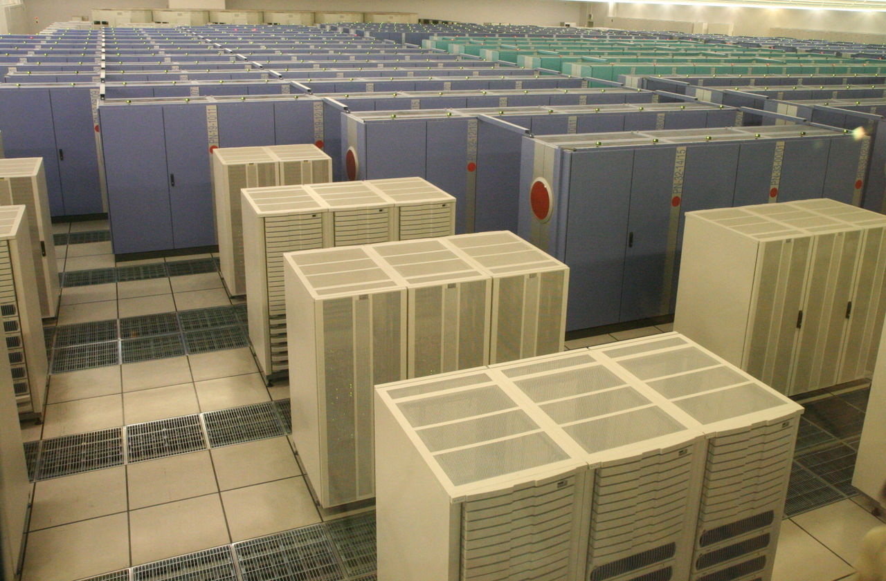
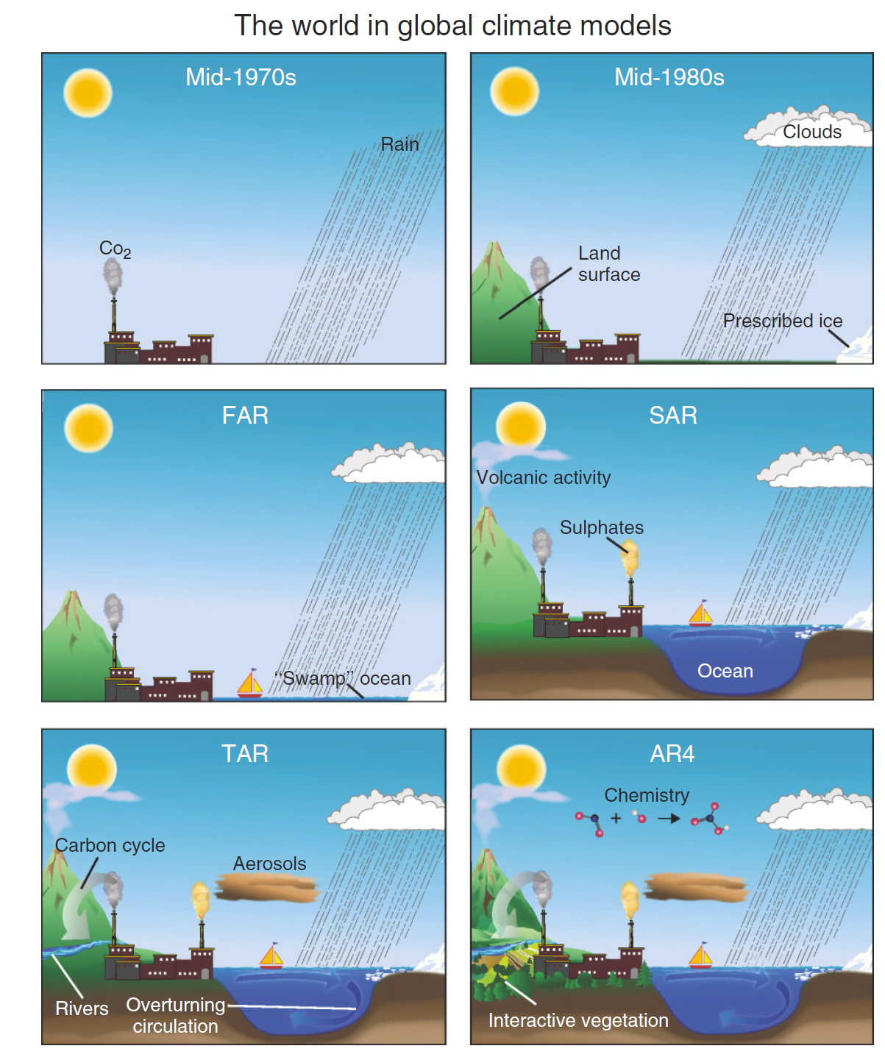
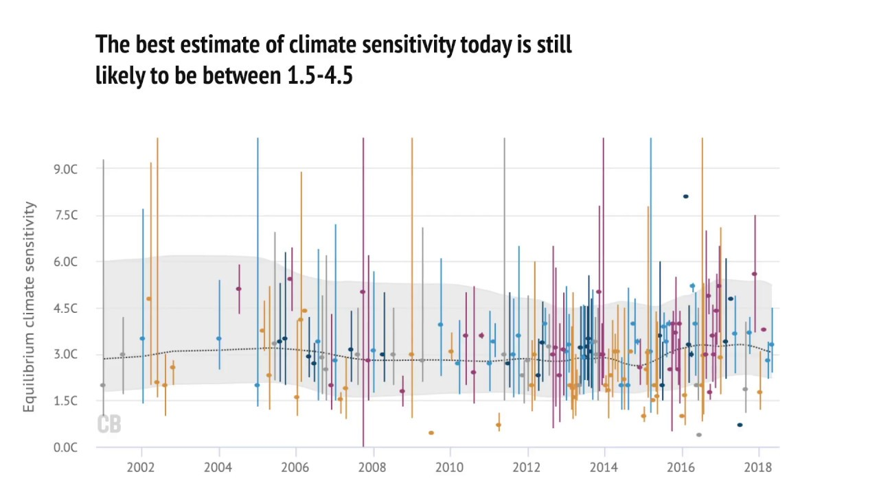
Earth system model
High-resolution, multi-component models of the earth system
IPCC, Climate Change 2007: The Physical Science Basis. Contribution of Working Group I to the Fourth Assessment Report of the Intergovernmental Panel on Climate Change. Cambridge University Press, United Kingdom and New York, NY, USA.
Pearce, Rosamund. 2018. “Explainer: How Scientists Estimate Climate Sensitivity.” Carbon Brief. June 19, 2018. https://www.carbonbrief.org/explainer-how-scientists-estimate-climate-sensitivity/.
“Earth Simulator.” 2022. In Wikipedia. https://en.wikipedia.org/w/index.php?title=Earth_Simulator&oldid=1123978018.

Slide 15
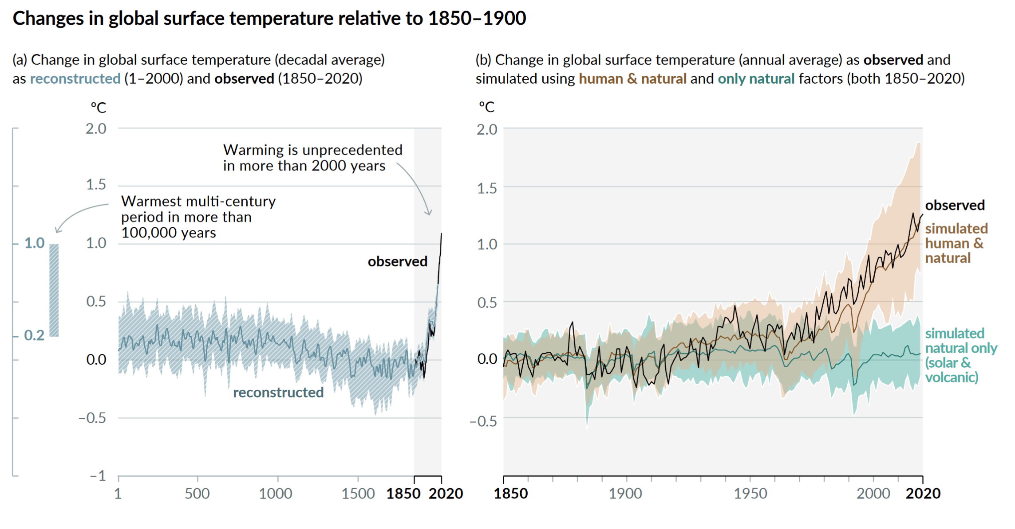
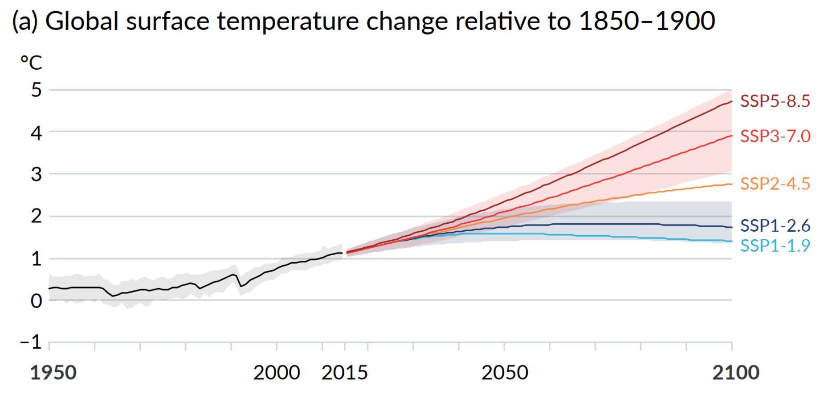
Conclusion from the science
“It is unequivocal that human influence has warmed the atmosphere, ocean and land.”
This is confirmed by a hierarchy of models:
From simple to complex
From pen and paper to high performance computing simulations
Manabe “predicted” global warming before its effect is apparent.
IPCC. 2021. “Summary for Policymakers.” Edited by V. Masson-Delmotte, P. Zhai, A. Pirani, S.L. Connors, C. Péan, S. Berger, N. Caud, et al. Climate Change 2021: The Physical Science Basis. Contribution of Working Group I to the Sixth Assessment Report of the Intergovernmental Panel on Climate Change. Cambridge, United Kingdom and New York, NY, USA: Cambridge University Press.

